Slide 1
#দাদার_ক্লাস
Facebook & Youtube :
#দাদার_ক্লাস #Dadar_Class
Dadar_Class

Slide 2

Computer?
Dadar_Class

Slide 3
Computer?
Hardware
Software
User
Software
Hardware
Dadar_Class

Slide 4
Hardware Software
Body
Life
Dadar_Class

Slide 5
Hardware?
Dadar_Class

Slide 6

Physics
Electrical Conductivity
Dadar_Class

Slide 7

Physics
Semi Conductor
Dadar_Class

Slide 8

Physics
Semi Conductor: N Type P Type
Dadar_Class

Slide 9

Electronics
Semi Conductor: N Type P Type: Transistor
Dadar_Class

Slide 10

Electronics
Semi Conductor: N Type P Type: Transistor: Gates
Dadar_Class

Slide 11

Electronics
Semi Conductor: N Type P Type: Transistor: Gates
Number System
Dadar_Class

Slide 12

Electronics
Semi Conductor: N Type P Type: Transistor: Gates
Number System
Adder
Counter
Register
Dadar_Class

Slide 13

Computer Hardware
CPU
Dadar_Class

Slide 14

Computer
Hardware
Software
Dadar_Class

Slide 15
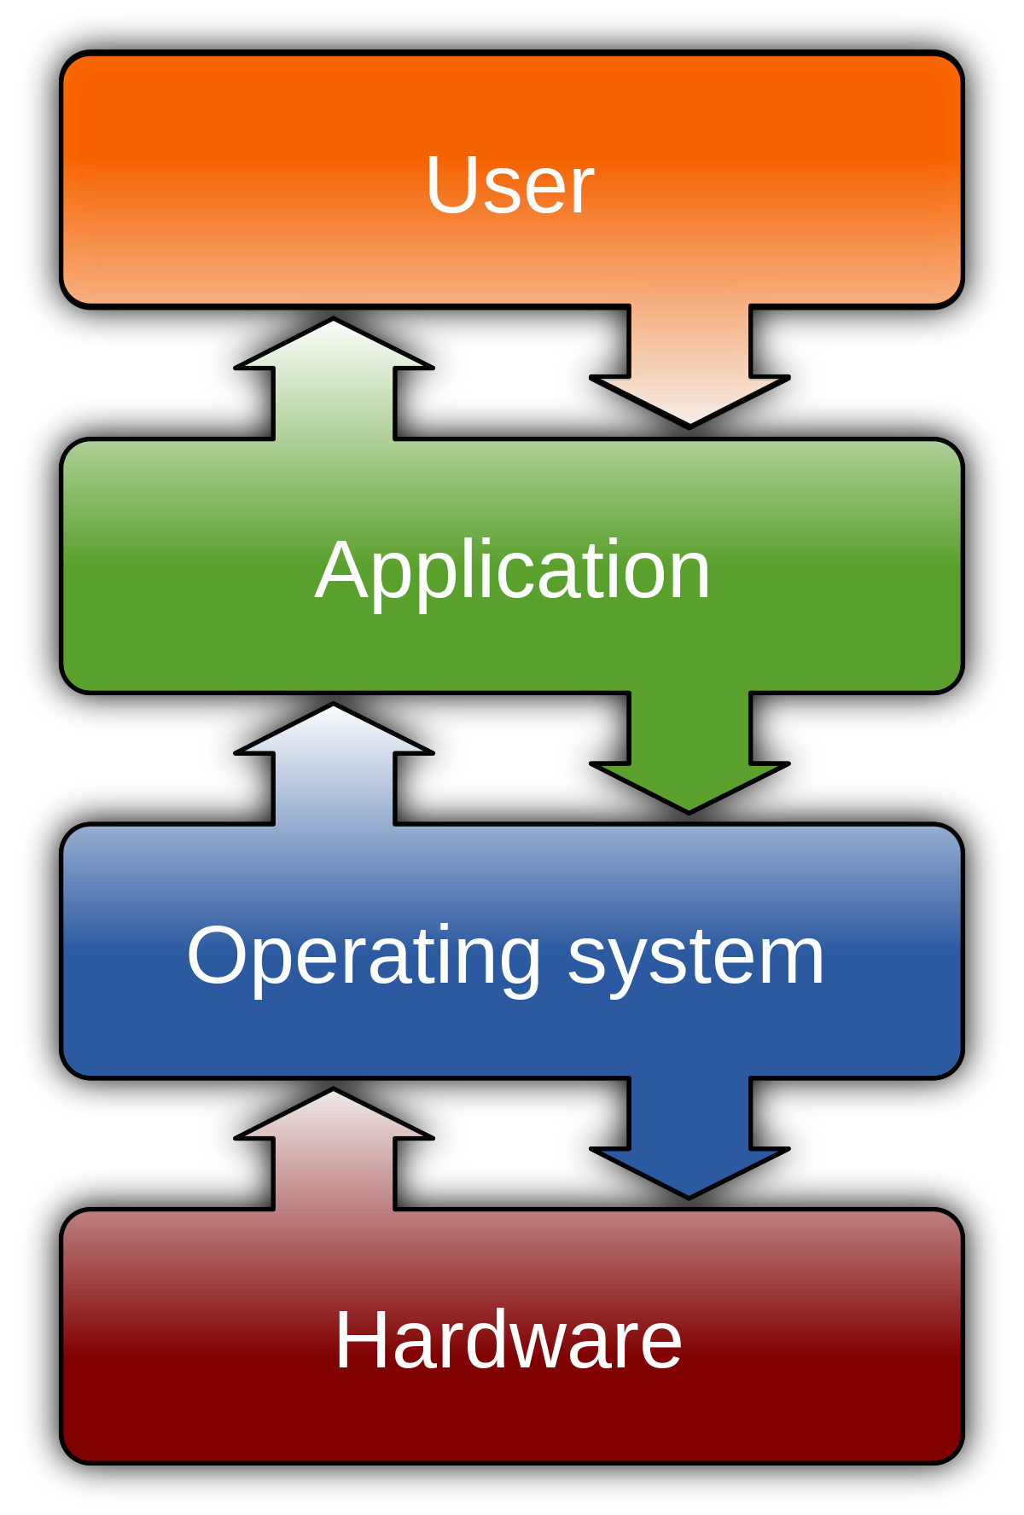

Computer Software
System Software
Application Software
Dadar_Class

Slide 16
Computer
Hardware
Computer Language
Software
Dadar_Class

Slide 17
Computer language
1st generation
2nd generation
3rd generation
4th generation
5th generation
Machine Code
Assembly Language
C, C++, Java
Python
Natural Language
Dadar_Class

Slide 18
Computer language
Logic
Algorithm
Structure
Data Storage (Data Base Management System)
Dadar_Class

Slide 19
#দাদার_ক্লাস
Facebook & Youtube :
#দাদার_ক্লাস #Dadar_Class
Dadar_Class

